Slide 1
(NON PROFIT ORGANIZATION)

Slide 2
Chronology of Rotary/Hospice in Mexico
2006 Hospice San Miguel
2007 Rotary Grant - education, outreach, equipment
2008 ELNEC Conference with David McGrew
2010 Rotary Equipment Grant
2012 ELNEC presentation INCAN annual conference
2016 Mitigare Founded
2016 Rotary Equipment/Start Up grant
2024 Rotary Global Grant Equipment and Furnishings

Slide 3
Planning Checklist for End of Life
Who will be responsible?
Where is the money, the key documents?
Who needs to be paid?
Who will take care of the pets?
Digital Access - email, banks, social media, passwords
Do you have a doctor who knows you and respects your wishes.

Slide 4
Planning Checklist for End of Life
Do you need a will? A disbursement letter of instructions?
Name beneficiaries to your financial accounts.
Will your employees be treated properly? Start date and salary must be recorded.
End of Life Wishes and Instructions - Advanced Directives and 5 Wishes
Should the Consul seal the property until relatives arrive?

Slide 5
The Greatest Gift - A Burial Plan
The most difficult moments
Pick up the body
Doctor certifies the cause of death
Execute burial or cremation agreement
Return passport, FM, social security
Notify Consulate with instructions
Certificates of Death - Mexico and USA

Slide 6
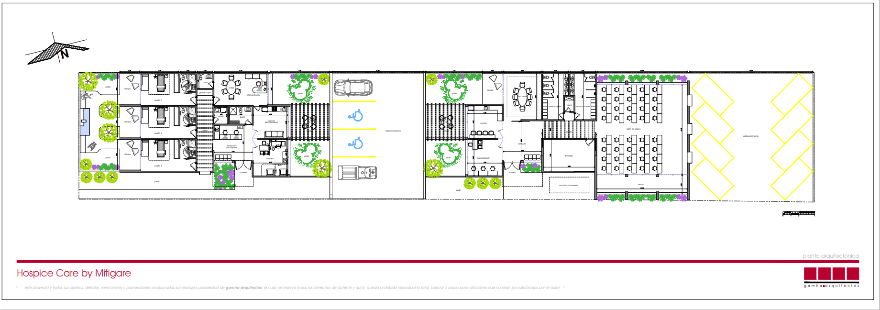
Hospice facility

Slide 7
Hospice House - Casa Hospice

Slide 8
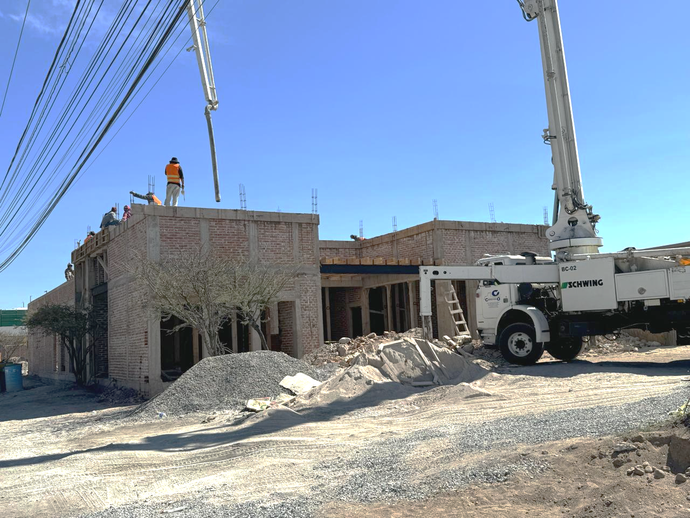
Hospice facility

Slide 9
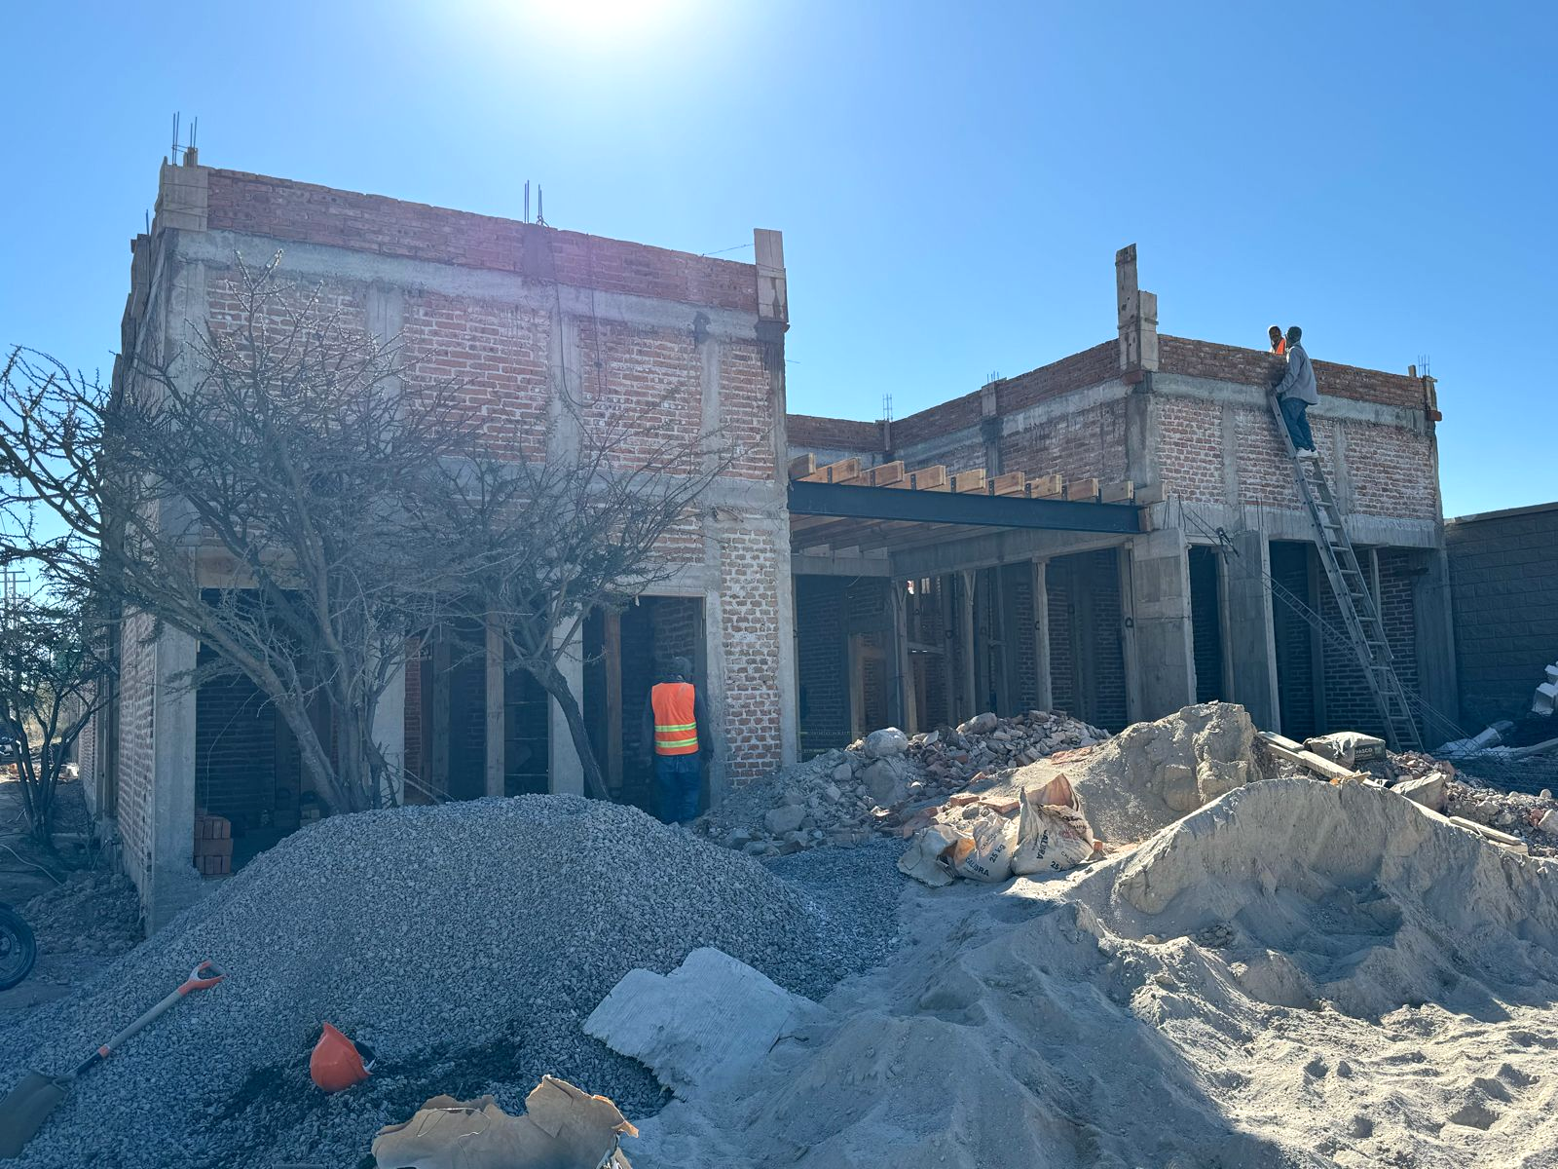
Hospice facility
Hospice facility

Slide 10
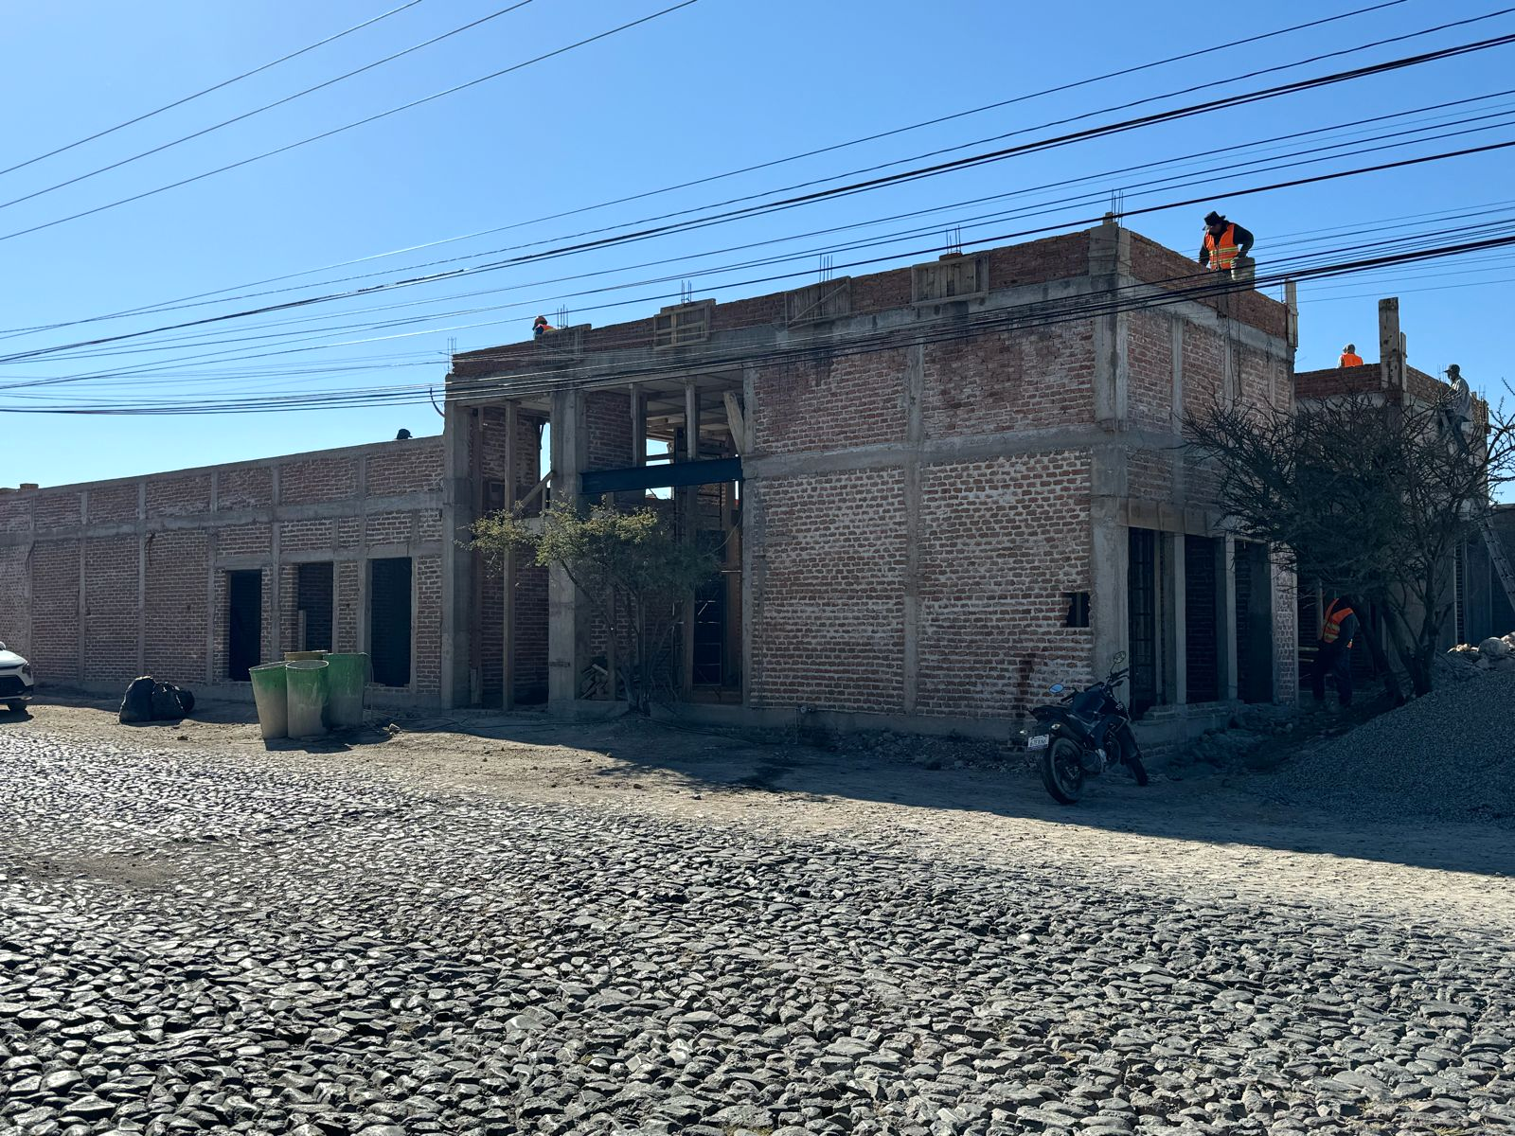
Hospice facility
Hospice facility

Slide 11
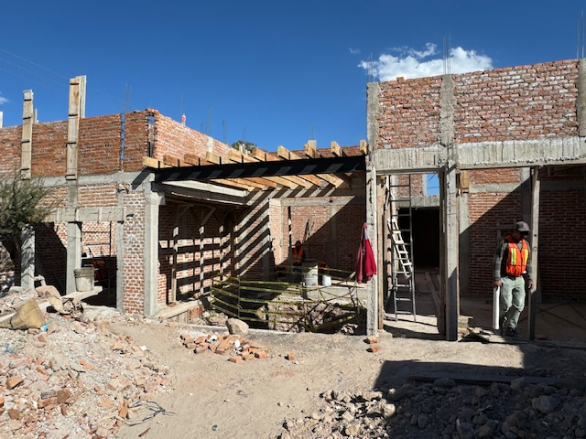
Hospice facility

Slide 14
Redefining Hospice Care
in Mexico

Slide 15
Inauguration of a New Facility
Demonstrating Unwavering Compassion
Incorporating State-of-the-Art Medical Equipment
Embracing Cutting-Edge Medical Support

Slide 16
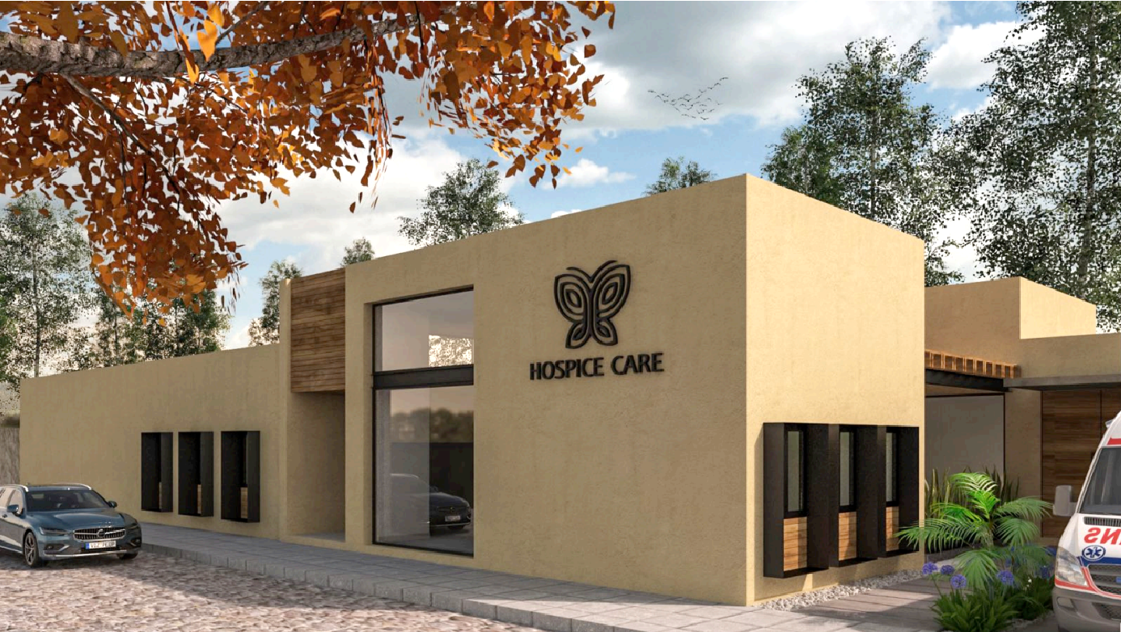
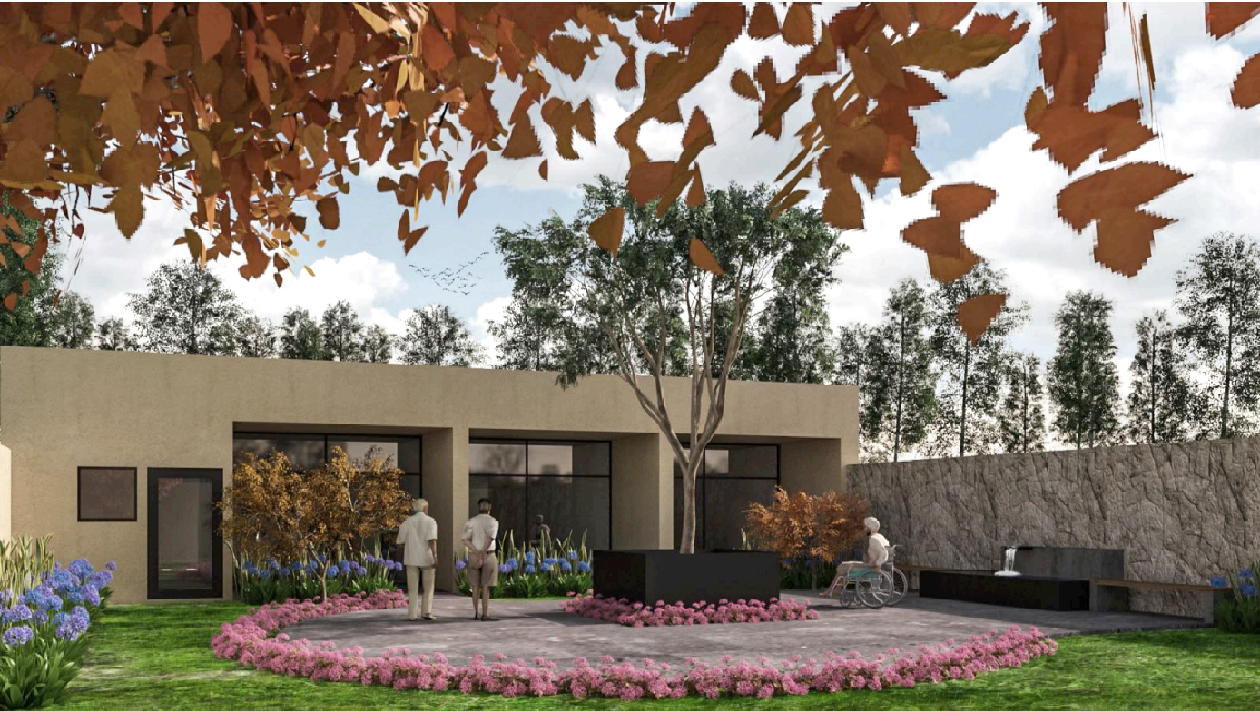
Unwavering Compassion and State-of-the-Art Support
A light of Hope
Marking a New Beginning
Enhancing Quality of Life

Slide 17
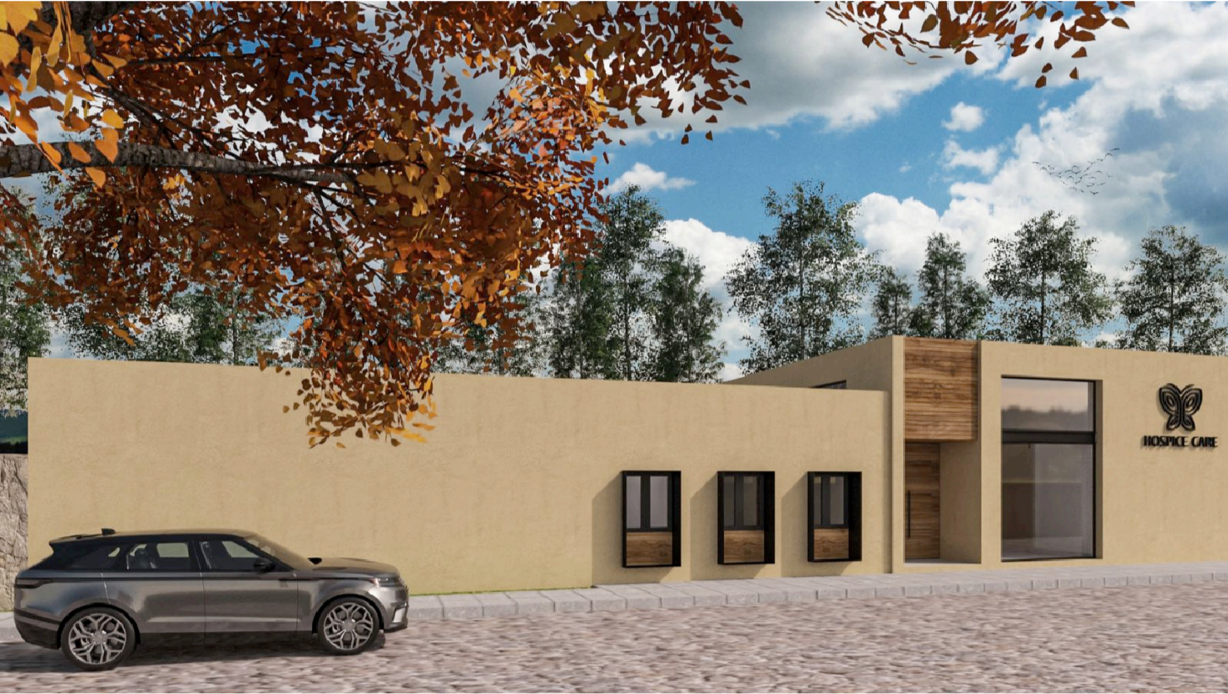
A Sanctuary for Compassionate Care
Nurturing Emotional Well-Being
Beyond a Building
Providing Comfort and Care

Slide 18
DOCTORS
NURSES
SOCIAL WORK
MEDICAL DIRECTOR
THANATOLOGY
SPECIALTIES
CARETAKERS
SPIRITUAL
VOLUNTEERS

Slide 19
Fueling Our Determination
Supporting a Paradigm of Care
Building a Supportive Community
Celebrating Transformative Power

Slide 20
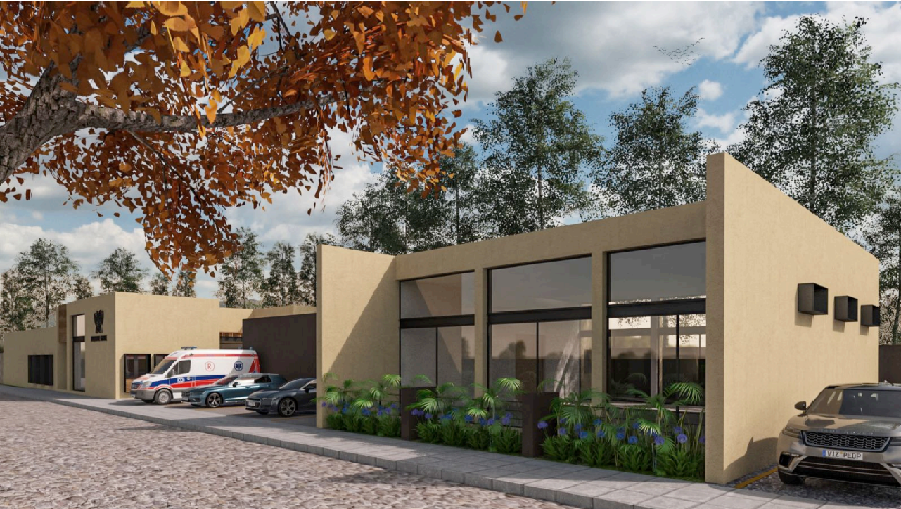
Honoring Every Life
Embracing Dignity
Celebrating Life
Ushering in a New Era

Slide 21
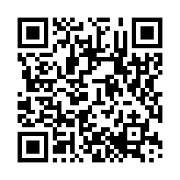
Information +52 415 111 76 37 Medical +52 415 138 6145
www.mitigare.org contacto@mitigare.org
The Foundation for
Hospice Care

Slide 22
End of life hospital based care
VS.
Take patient out of home, away from loved ones
Higher cost, for home visit or for hospitalization
Difficult Access to pain medication
Limited space, patients discharged
Hospice Care service at home with family and loved ones
Comprehensive care: Doctors. Nurses, Social Work, Thanatology, etc.
Access to medicines to control symptoms
Available medical equipment
Sliding payment schedule based on ability to pay
End of life with dignity, peace and respect for the patient & family

